Slide 1


Angular with Clarity
+

Slide 2
Angular with Clarity
Angular
Clarity
Front-end web application platform
TypeScript-based
Open-sourced by Google
http://angular.io
UX guidelines
HTML/CSS framework
Angular components
Open-sourced by VMware
http://clarity.design

Slide 3
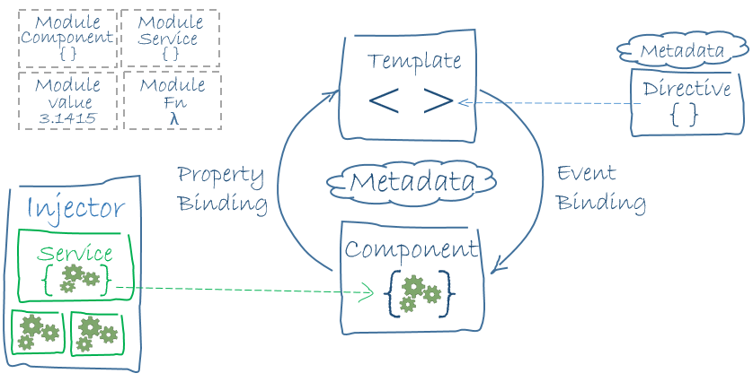
Angular in a nutshell
(image source: https://angular.io/docs/ts/latest/guide/architecture.html)
Notes:
You can write an Angular app by writing HTML templates with Angular markup and writing component classes that manage those templates and injecting services into the components for application logic. All of these are packaged in units called modules and the application is started by bootstrapping the root module.

Slide 4
In this workshop you’ll learn how to..
Create an Angular application
Create components
Write and inject services
Retrieve data using HTTP
Work with navigation and routing

Slide 5
Getting started with Clarity seed
Prerequisite: Install Node.js
Clone and start up the latest version of Clarity seed
# clone the latest version of Clarity seed
git clone https://github.com/vmware/clarity-seed.git
cd clarity-seed
# install the project’s dependencies
npm install
# starts the application in dev mode and watches your files for livereload
ng serve

Slide 6
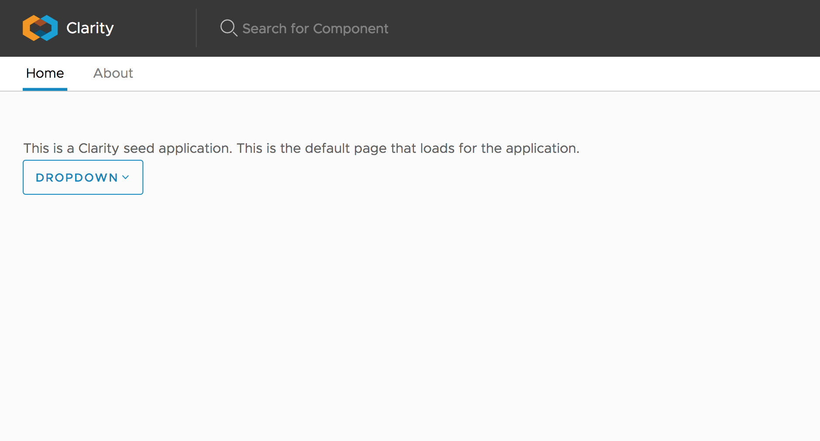
Getting started with Clarity seed

Slide 7
Angular-cli
Command line interface tool for speedy Angular code generation
Clarity seed is already wired with angular-cli, so you are ready to begin!
# install angular-cli globally
npm install -g @angular/cli
# generating a new component
ng g component my-new-component
# generating a new service
ng g service my-new-service
# to learn more about Angular-CLI commands and their usages
ng help

Slide 8
Angular Module
An angular application has at least one app-level module
import { ROUTING } from "./app.routing";
@NgModule({ declarations: [ AppComponent, AboutComponent, HomeComponent ], imports: [ BrowserAnimationsModule, BrowserModule, FormsModule, HttpModule, ClarityModule.forRoot(), ROUTING ], providers: [], bootstrap: [AppComponent] }) export class AppModule { }
Notes:
Take a look at the @NgModule decorator. Decorators are functions that modify JavaScript classes. Later you’ll see @Component decorator which will be used to add metadata to components.
In main.ts, this AppModule is bootstrapped.
(Below notes taken from: https://angular.io/docs/ts/latest/guide/architecture.html)
declarations - the view classes that belong to this module. Angular has three kinds of view classes: components, directives, and pipes.
exports - the subset of declarations that should be visible and usable in the component templates of other modules.
imports - other modules whose exported classes are needed by component templates declared in this module.
providers - creators of services that this module contributes to the global collection of services; they become accessible in all parts of the app.
bootstrap - the main application view, called the root component, that hosts all other app views. Only the root module should set this bootstrapproperty.

Slide 9
Angular Routing
In our app, app.routing.ts contains all the routes for the application
import { ModuleWithProviders } from '@angular/core/src/metadata/ng_module'; import { Routes, RouterModule } from '@angular/router'; import { AboutComponent } from './about/about.component'; import { HomeComponent } from './home/home.component'; export const ROUTES: Routes = [ {path: '', redirectTo: 'home', pathMatch: 'full'}, {path: 'home', component: HomeComponent}, {path: 'about', component: AboutComponent} ]; export const ROUTING: ModuleWithProviders = RouterModule.forRoot(ROUTES);

Slide 10
Writing a component
Let’s modify our home component to display some cards
<div class="row"> <div class="col-lg-6 col-md-12 col-sm-12 col-xs-12"> <a href="..." class="card clickable"> <div class="card-img"> <img src="..."> </div> <div class="card-block"> <p class="card-text"> ... </p> </div> </a> </div> </div>

Slide 11
Directive – ngFor
You can use ngFor for repeated code
export class HomeComponent { urls: string[] = [ "url1", "url2", "url3" ];
…
}
<div class="row"> <div class="col-lg-4 col-md-12 col-sm-12 col-xs-12" *ngFor="let url of urls"> <a class="card clickable card-img"> <img [src]=”url" alt="..." /> </a> </div> </div>
Notes:
Components—directives with a template.
Structural directives—change the DOM layout by adding and removing DOM elements.
Attribute directives—change the appearance or behavior of an element, component, or another directive.

Slide 12
Writing a service
Let’s write a service to retrieve photos to display
# this command should generate two files: photo.service.ts and photo.service.spec.ts
ng g service photo
export class PhotoService { constructor() { } getPhotos() : string[] { return [ ”<url1>", ”<url2>", ”<url3>" ]; } }

Slide 13
Injecting service
Now our home component can use the service to retrieve the data
import {PhotoService} from "../photo.service"; @Component({ styleUrls: ['./home.component.scss'], templateUrl: './home.component.html', providers: [PhotoService] }) export class HomeComponent { urls: string[] = []; constructor(private photoService: PhotoService) { this.urls = photoService.getPhotos(); }
…
}

Slide 14
Retrieve data using HTTP
Let’s modify our photo service to retrieve data using flickr’s REST API
import { Injectable } from '@angular/core';
import { Http } from "@angular/http"; @Injectable() export class PhotoService { constructor(private http: Http) { } getPhotos() { …. }
}

Slide 15
Retrieve data using HTTP
Let’s modify our photo service to retrieve data using flickr’s REST API
import { Observable } from "rxjs/Observable"; import 'rxjs/add/operator/map'; import 'rxjs/add/operator/catch';
@Injectable()
export class PhotoService { private restUrl: string = "https://api.flickr.com/services/rest/?method=flickr.photos.search"; private apiKey: string = ”<flickr api key>"; getPhotos() { let query = "flowers"; // we’ll come back to this to make it dynamic from user input let url = `${this.restUrl}&api_key=${this.apiKey}&tags=${query}&format=json&nojsoncallback=1`; return this.http.get(url).map((data: any) => data.json()) .catch((error: any) => Observable.throw(error)); } }
Notes:
RxJS, the reactive extensions for javascript, is a set of libraries to compose asynchronous and event-based programs using observable collections and Array#extras style composition in JavaScript.

Slide 16
Sample JSON response from Flickr API
You can use the data to construct URLs in our application.
{ "photos": { "page": 1, "pages": 65493, "perpage": 3, "total": "196477", "photo": [ { "id": "33223334163", "owner": "133737760@N07", "secret": "f05312a891", "server": "3948", "farm": 4, "title": "P1110472.jpg", "ispublic": 1, "isfriend": 0, "isfamily": 0 }, … ] }, "stat": "ok" }

Slide 17
Subscribing to the Observable
Let’s go back to the home component to use the retrieved data
export class HomeComponent { urls: string[] = []; errorMessage: string; constructor(private photoService: PhotoService) { photoService.getPhotos() .subscribe( result => { result.photos.photo.forEach(data => { this.urls.push(`https://farm${data.farm}.staticflickr.com/${data.server}/
${data.id}_${data.secret}.jpg`); }); }, error => this.errorMessage = error; ); }
}

Slide 18
Subscribing to the Observable
Adding a more robust error handling:
constructor(private photoService: PhotoService) { this.urls = []; delete this.errorMessage; photoService.getPhotos() .subscribe( result => { if (result.stat === "ok") { result.photos.photo.forEach(data => { this.urls.push(`https://farm${data.farm}.staticflickr.com/${data.server}/
${data.id}_${data.secret}.jpg`); }); } else { this.errorMessage = result.message; } }, error => this.errorMessage = error; ); }

Slide 19
Directive – ngIf
We only want to show an alert if there is an error:
We can test that the error message shows by putting an invalid API key
<div class="alert alert-danger" *ngIf="errorMessage"> <div class="alert-item"> <span class="alert-text"> {{errorMessage}} </span> </div> </div> <div class="row"> … </div>

Slide 20
Writing a component – data binding
Let’s put an input field in the component for search
Data flow in Angular:
<form> <input type="text" placeholder="Search" #query> <button type="submit" class="btn btn-primary" (click)="onClick(query.value)">Search</button> </form> <div class="row"> ... </div>
Data direction | Syntax
data source to view target | {{expression}} or [target]=“expression”
view target to data source | (target)=“statement”
two-way | [(target)]=“expression”

Slide 21
Writing a component
We move the functionality of retrieving photo data to a function
export class HomeComponent { constructor(private photoService: PhotoService) {} onClick(query: string) { this.urls = []; delete this.errorMessage; this.photoService.getPhotos(query) .subscribe( ... ); } }

Slide 22
Revisiting our service
Now we can modify the service to take user’s search query as input
export class PhotoService { private restUrl: string = "https://api.flickr.com/services/rest/?method=flickr.photos.search"; private apiKey: string = ”<api key>"; constructor(private http: Http) { } getPhotos(query: string) { let url = `${this.restUrl}&api_key=${this.apiKey}&tags=${query}&format=json&nojsoncallback=1`; return this.http.get(url) .map((data: any) => data.json()) .catch((error: any) => Observable.throw(error)); } }

Slide 23
Indicating progress
export class HomeComponent { … loading: boolean = false; onClick(query: string) { this.loading = true;
… this.photoService.getPhotos(query) .subscribe( result => {
… }, error => { … },
() => this.loading = false; ); } }

Slide 24
Indicating progress
Let’s add a loading spinner and disable the search button while data is being retrieved
<form> <input type="text" placeholder="Search" #query> <button type="submit" class="btn btn-primary" (click)="onClick(query.value)"
[disabled]="loading">Search</button> <span class="spinner spinner-inline" *ngIf="loading"> Loading... </span> </form>

Slide 25
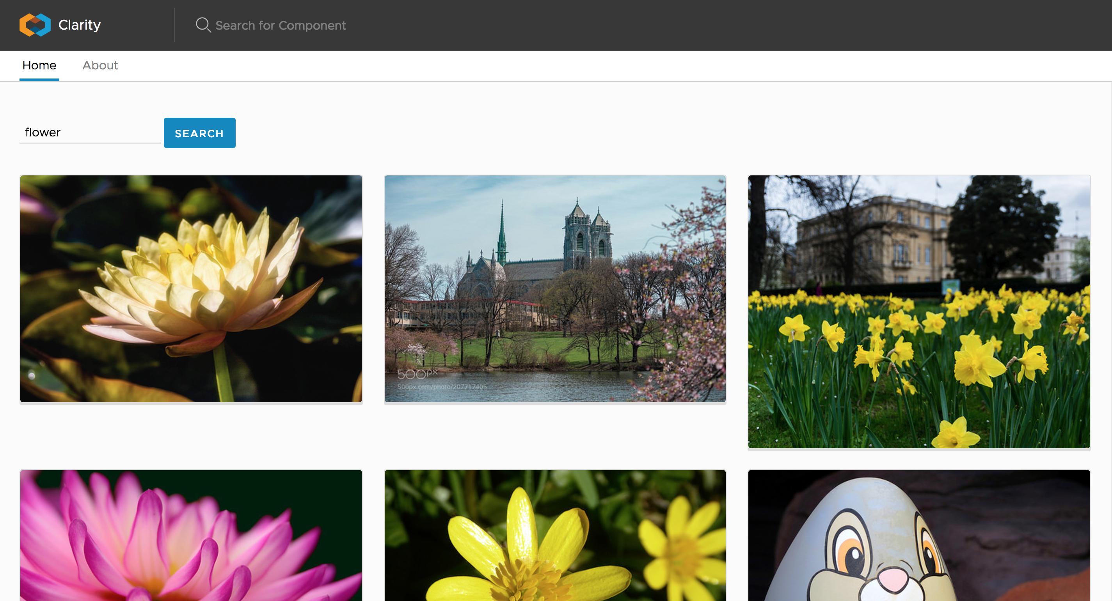
The final product

Slide 26
What we didn’t get to cover in this workshop
RxJS in detail
Animations
Lifecycle hooks
Pipes
Security
….

Slide 27
What’s next?
Build more Angular applications
Contribute to open-source
https://github.com/angular/angular
https://github.com/vmware/clarity

Slide 28
Thank you
+

